Slide 1

Title:ATM Machine Digital Transaction model
Student Name: V. Sri Bhargavi
Student ID: 2520040048
Cluster:2
Section: 7
Under the Guidance
of
Supervisor Name: xxxxxxxx
Assistant Professor
Department of CSE

Slide 2
Abstract
The ATM Machine Digital Transaction model is a browser-based banking application developed using HTML, CSS, and JavaScript. It replicates real-time ATM operations through a secure three-level authentication mechanism that includes mobile number entry, One-Time Password (OTP) verification, and ATM PIN validation. This layered authentication enhances security before granting access to account features, ensuring safe and controlled user access.
After successful login, the application enables users to perform essential banking activities such as deposit, withdrawal, internal and external transfers, interest calculation, PIN modification, card blocking, QR code generation, and transaction history viewing. Account balance, daily withdrawal limits, and transaction records are maintained using structured data handling within the program. The project demonstrates the practical implementation of secure authentication, transaction handling, and interactive user interface design in a digital banking simulation environment.

Slide 3
Existing System
Traditional ATM systems use ATM cards and PIN authentication for accessing banking services.
Users must insert the card into the ATM machine to start transactions.
The system allows basic operations such as balance inquiry, cash withdrawal, and deposit.
Security mainly depends on PIN verification, which can be risky if the PIN is exposed.
There is no OTP-based authentication for additional security.
Transaction records are usually not easily accessible to users in digital format.
The system does not provide features like QR code generation or PDF account statements.
Limited functionality compared to modern digital banking systems.

Slide 4
Proposed System
The proposed system is a web-based ATM simulation system developed using HTML, CSS, and JavaScript.
It provides multi-level authentication using mobile number, OTP verification, and PIN login.
Users can perform banking operations such as deposit, withdrawal, internal transfer, and external transfer.
The system maintains transaction history and displays the last five transactions.
It includes additional features like interest calculation, QR code generation, and PDF account statement download.
Users can also change their ATM PIN and block their card for security purposes.
The system improves security, accessibility, and convenience compared to traditional ATM systems.
It provides a simple and user-friendly interface for digital banking operations.

Slide 5
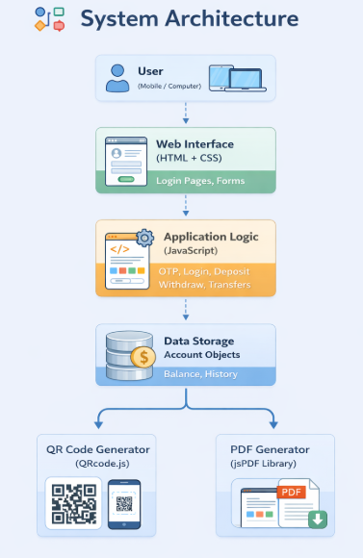
System Architecture
The system follows a simple client-side architecture using web technologies.
Components:
User Interface (Frontend):
Built using HTML and CSS
Provides pages for login, transactions, and account details
Application Logic:
Implemented using JavaScript
Handles authentication, transactions, and calculations
Data Storage:
Account data stored in JavaScript objects
Stores balance, bank name, limit, and transaction history
External Libraries:
QRCode.js for generating QR codes
jsPDF for generating PDF account statements
Flow: User → OTP Verification → PIN Login → Banking Operations → Transaction History / PDF / QR

Slide 6
Project Modules
Authentication Module – Handles mobile number, OTP verification, and PIN login.
Account Module – Displays bank name, balance, and daily transaction limit.
Transaction Module – Performs deposit, withdrawal, and money transfers.
History Module – Stores and shows transaction history and last 5 transactions.
Security Module – Allows PIN change and ATM card blocking.
Report Module – Generates QR code and downloads account statement as PDF.

Slide 7
Objectives
To develop a secure ATM simulation using web technologies.
To implement multi-level authentication using OTP and PIN.
To provide basic banking operations such as deposit, withdrawal, and transfer.
To maintain transaction history and account details.
To generate QR codes and downloadable PDF account statements.
To improve user convenience, security, and digital banking experience.

Slide 8
Co’s Attainments - FWD
co’s | Co Topics | Topics Covered in ATM Project Code
Co - 1 | Internet Fundamentals, HTML & Introductory CSS | HTML page structure, headings, forms, buttons, input fields, basic CSS styling, page layout.
Co - 2 | HTML Forms & CSS Layout | Form inputs (mobile number, OTP, PIN), validation attributes, responsive UI design, styled buttons and pages.
Co - 3 | JavaScript Programming Essentials | Variables, conditions (if/else), functions, objects, arrays, mathematical operations for balance and transactions.
Co - 4 | JavaScript Interactivity, DOM & Events | DOM manipulation (getElementById), event handling (onclick), dynamic page navigation, transaction history display.
Co - 5 | Advanced Web Development | DOM manipulation (getElementById), event handling (onclick), dynamic page navigation, transaction history display.

Slide 9
Co’s Attainments - DSA
Co’s | Co Topics | Topics Covered in Code
Co - 1 | Analyze searching and sorting algorithms | Time Complexity, Linear Search, Binary Search, Sorting Algorithms
Co - 2 | Implement linked list data structures | Singly Linked List, Doubly Linked List, Circular Linked List
Co - 3 | Apply stack and queue structures | Stack, Queue, Circular Queue, Expression Evaluation
Co - 4 | Design hash-based data structures | Hashing, Collision Handling Techniques
Co - 5 | Use linear data structures in applications | Applications of Linear Data Structures
Co - 6 | Develop programs using data structures | Implementation of Data Structure Programs

Slide 10

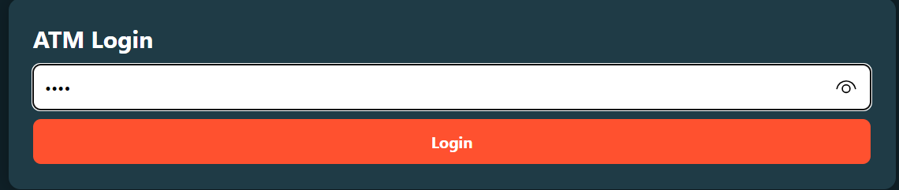
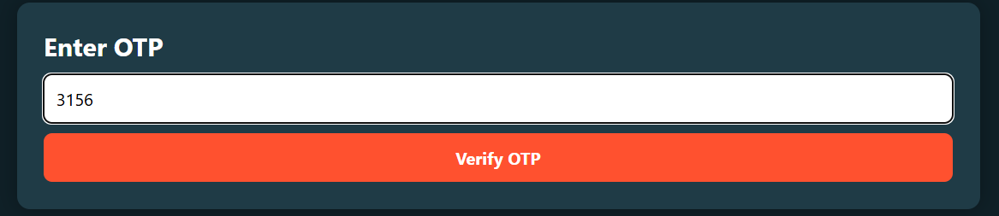
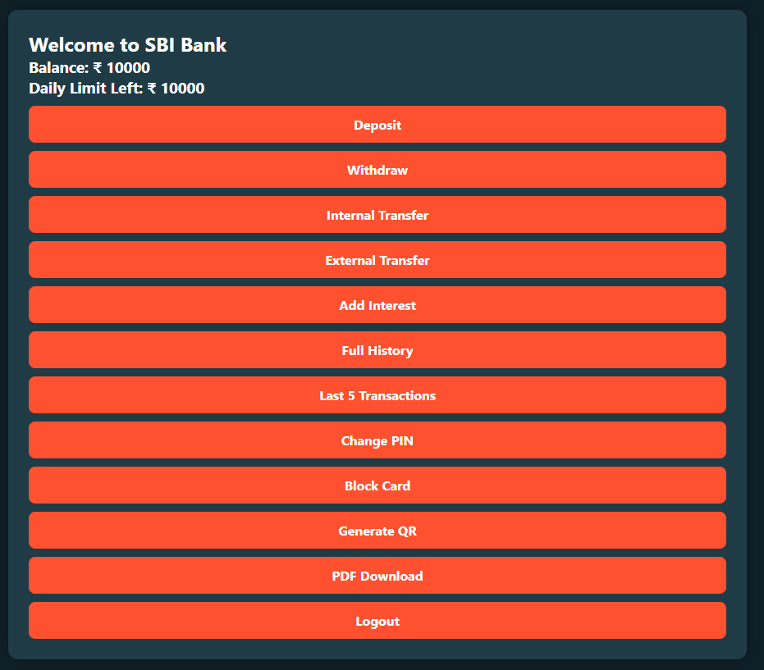
Screenshots for FWD & DSA

Slide 11

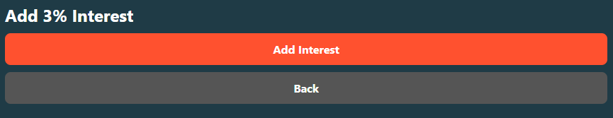



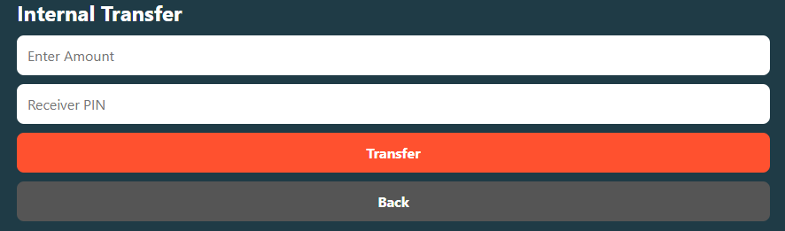

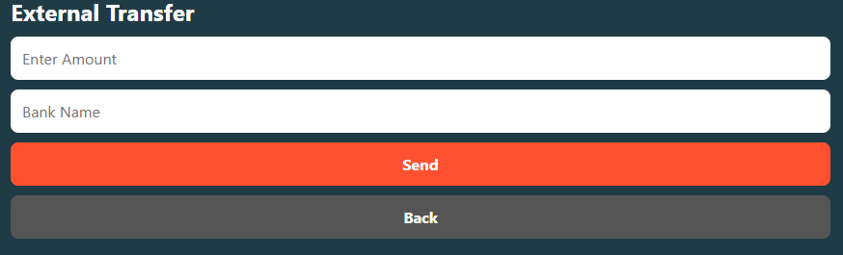

Slide 12

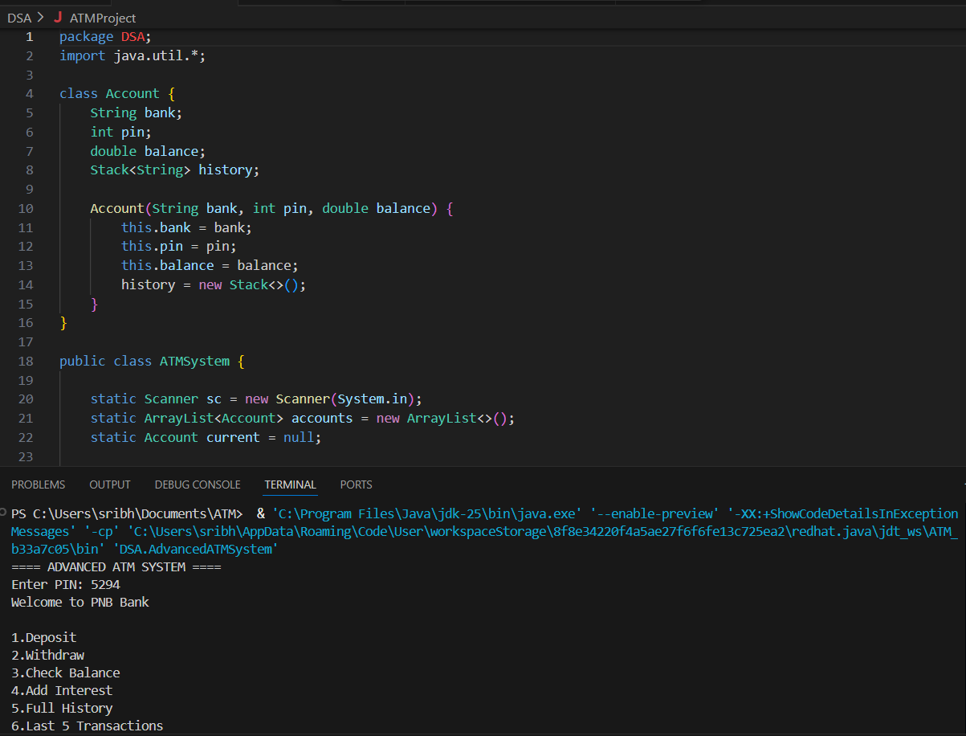

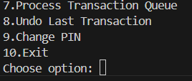

Slide 13
Conclusion
The project demonstrates how HTML, CSS, and JavaScript can be used to develop a web-based ATM system.
It implements multi-level authentication using mobile number, OTP verification, and PIN login for better security.
The system allows users to perform deposit, withdrawal, and money transfer operations easily.
It maintains transaction history and displays the last five transactions for user reference.
Additional features like QR code generation and PDF account statement download improve functionality.
The system provides a simple and user-friendly interface for banking operations.
It enhances security, efficiency, and convenience in digital banking services.
The project helps in gaining practical knowledge of web development and system implementation.

Slide 14
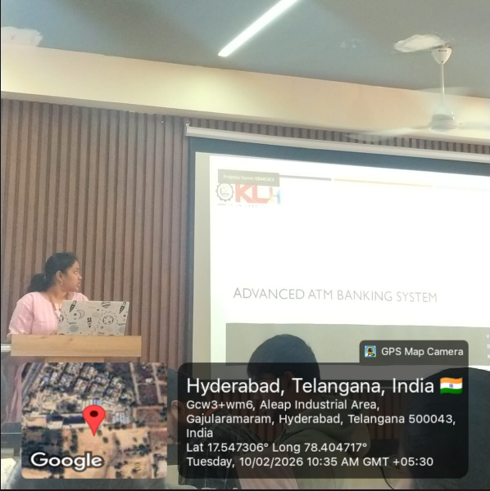
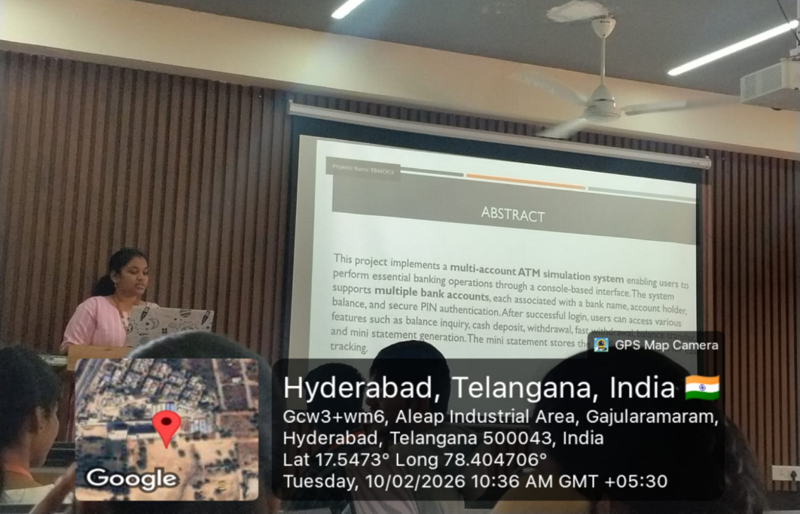
Geo- Tag Photos

Slide 15
THANK YOU

